Slide 1
The legalities and humanitarian implications of Australia’s regional offshore processing agreements
International Association of Refugee Law Judges
(IARLJ) Conference
Pretoria, South Africa
26-28 October 2016
Justice Debbie Mortimer
Federal Court of Australia
Notes:
With my thanks to my Associate, Ms Simone King, for her considerable assistance in preparing these materials.

Slide 2
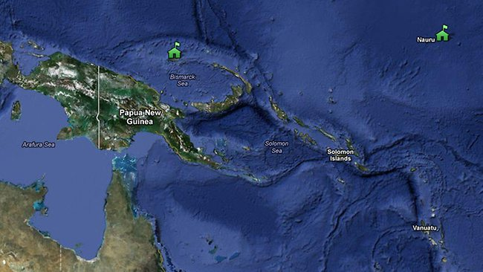
Manus Island and Nauru Regional Processing Centres

Slide 3
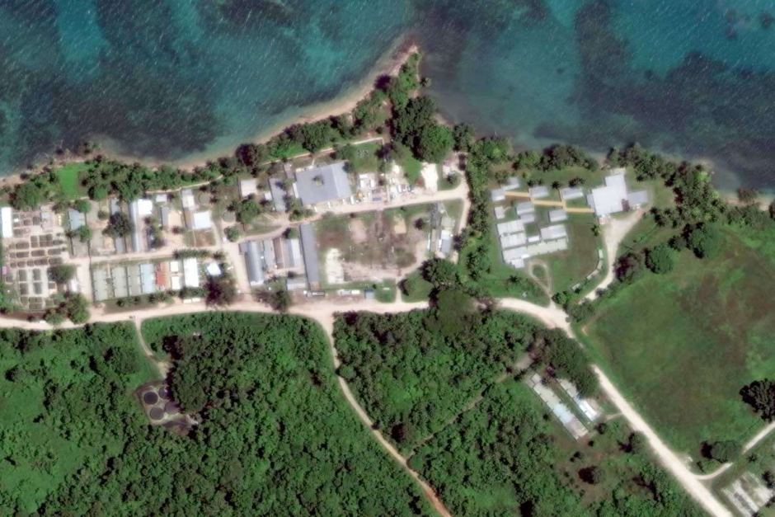
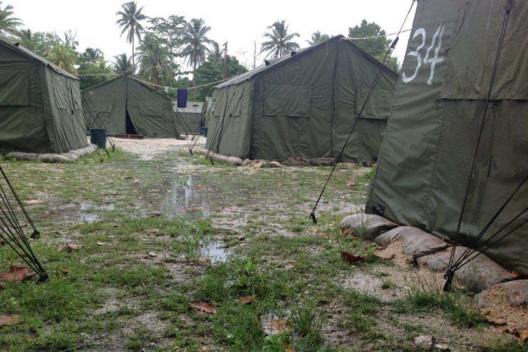
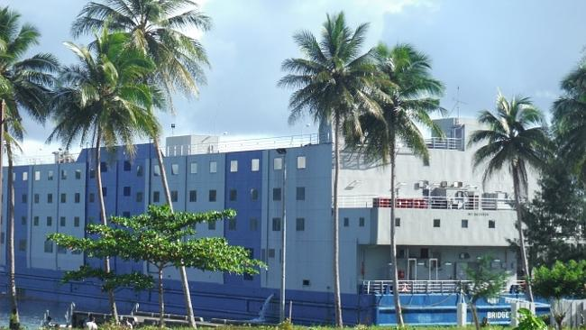
Manus Island Regional Processing Centre Papua New Guinea

Slide 4
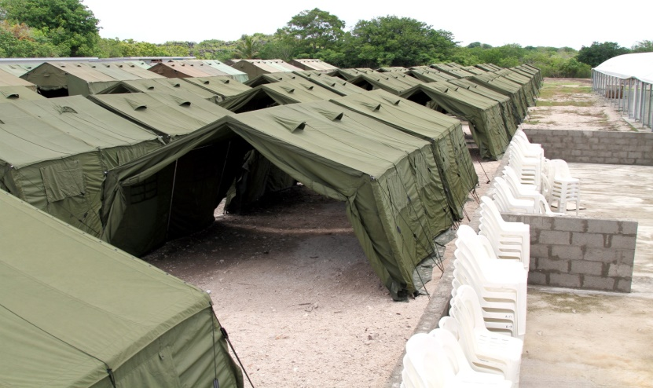
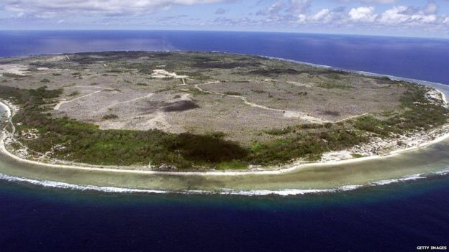
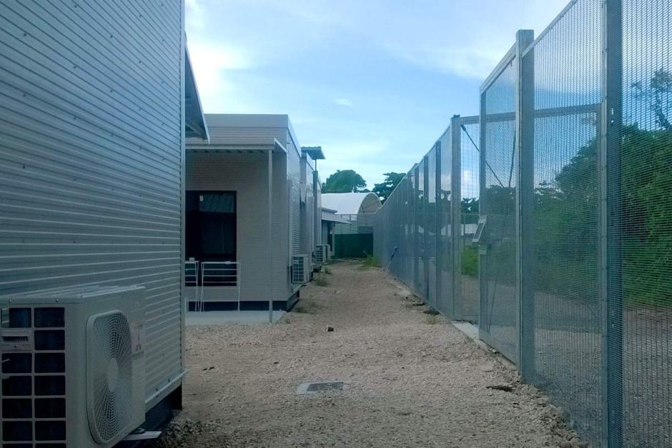
Nauru Regional Processing Centre

Slide 5
Background – Manus and Nauru
Opened for operation in 2001, as part of the Howard government’s “Pacific Solution”.
Australia signed an Administrative Agreement with Nauru on 10 September 2001 and a Memorandum of Understanding (MOU) with Papua New Guinea on 11 October 2001 to give effect to the arrangements.
Offshore processing was suspended by the Rudd Labor government in early 2008 and the two centres were closed between early 2008 and September 2012.

Slide 6
Background – Manus and Nauru
In August 2012, the Gillard Labor government introduced a policy similar to the Pacific Solution and reopened Nauru and Manus processing centres.
After the centres were reopened, the first asylum seekers arrived in Nauru on 15 September 2012 and on Manus on 21 November 2012.
While both male and female asylum seekers were transferred to Manus Island from 21 November 2012 to 4 July 2013, after July 2013, all women and children have been sent to Nauru.

Slide 7
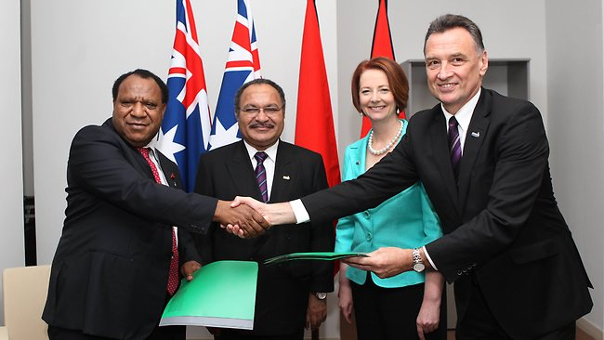
The most recent MOUs
The most recent MOUs were signed between Australia:
and Papua New Guinea, on 6 August 2013;
and Nauru, on 3 August 2013.

Slide 8
Extract from MOU with PNG
Guiding Principles
The Government of Australia will conduct all activities in respect of this MOU in accordance with its Constitution and all relevant domestic laws.
The Government of Papua New Guinea will conduct all activities in respect of this MOU in accordance with its Constitution and all relevant domestic laws.
The Government of Australia will bear all costs incurred under this MOU.
Separate to the costs incurred for the specific operation of this MOU, the participants will develop a package of assistance and other bilateral cooperation, which will be in addition to the current allocation of Australian development cooperation assistance to PNG, and taking into consideration priorities which are consistent with the revised PNG-Australia Partnership for Development (endorsed by both Governments on 12 October 2011). This includes specific measures agreed to by Participants through the Joint Understanding between Australia and Papua New Guinea on Further Bilateral Cooperation on Health, Education and Law and Order, agreed on 19 July 2013.

Slide 9
Extract from MOU with PNG
Operation of this MOU
Australia may transfer and Papua New Guinea will accept transferees from Australia under this MOU.
Administrative measures giving effect to this MOU will be settled between the Participants. Any further specific arrangements may be made, as jointly determined to be necessary by the Participants, on more particular aspects of this MOU for the purpose of giving effect to its objectives.

Slide 10
Extract from MOU with PNG
Persons to be transferred to Papua New Guinea for processing
Persons to be transferred to Papua New Guinea are those persons who:
have travelled irregularly by sea to Australia; or
have been intercepted at sea by the Australian authorities in the course of trying to reach Australia by irregular means; and
are authorised by Australian law to be transferred to Papua New Guinea; and
have undergone a short health, security and identity check in Australia.

Slide 11
Recent Statistics
According to Australian Government Department of Immigration and Border Protection statistics, on 31 August 2016, there were:
410 (306 men, 55 women, 49 children) detainees on Nauru; and
823 (all male adult) detainees on Manus Island.
At the same reporting date, there were 1355 people in immigration detention on the mainland and 247 in immigration detention on Christmas Island.

Slide 12
Past Statistics
However, there have been much higher numbers of detainees in the past.
In the period September 2012-May 2016, the numbers of detainees peaked:
on Manus Island at 1,353 in January 2014;
on Nauru at 1,233 in August 2014.

Slide 13
Reviews and Reports
There have been numerous reports on and reviews into the offshore processing arrangements, by both government bodies, NGOs and the United Nations.
For a recent list of the reports and inquiries, see “Australia’s offshore processing of asylum seekers in Nauru and PNG: A Quick Guide to statistics and resources” online http://www.aph.gov.au/About_Parliament/Parliamentary_Departments/Parliamentary_Library/pubs/rp/rp1516/Quick_Guides/Offshore

Slide 14
Island of Despair: Amnesty International Report (October 2016)
AI interviewed refugees and asylum seekers on Nauru, current and former contract workers who delivered services on Nauru on behalf of the Australian government, to compile its 2016 report: Island of Despair.
The report concluded: “The government of Australia's “processing” of refugees and asylum-seekers on Nauru is a deliberate and systematic regime of neglect and cruelty, and amounts to torture under international law.”
Report accessible at: https://www.amnesty.org.au/island-of-despair-nauru-refugee-report-2016/
The Australian Government has refuted most of the claims in the Amnesty report:http://newsroom.border.gov.au/releases/response-to-amnesty-international-report-on-nauru

Slide 15
Court decisions relating to Australia’s offshore processing arrangements
Plaintiff S156/2013 v Minister for Immigration and Border Protection & Anor [2014] HCA 22
CPCF v Minister for Immigration and Border Protection [2015] HCA 1
Namah v Pato [2016] PGSC 13
Plaintiff M68/2015 v Minister for Immigration and Border Protection [2016] HCA 1
Plaintiff S99/2016 v Minister for Immigration and Border Protection [2016] FCA 483

Slide 16
Recent changes to offshore processing arrangements
In October 2015, the Nauru processing centre became an “open centre” (this change was implemented just before M68 was handed down).
The Manus centre adopted similar measures in May 2016 (soon after the Namah v Pato decision).
In August 2016, the Minister for Immigration and Border Protection Peter Dutton announced, after meeting with the PNG Prime Minister, that the Manus Island Centre would close
As of October 2016, Manus IC has not closed.

Slide 17
Costs of offshore processing
Australian National Audit Office estimates that operations on Nauru and Manus cost over AUD$573,000 (USD$419,425) per person per year (Source: Amnesty International, Island of despair: Australia's processing of refugees on Nauru 2016, p.4)
Australia pays Nauru visa fees for transferred asylum seekers . To 30 March 2015, cost was more than AUD$ 27 million: see Plaintiff M 68/2015 [2016] HCA 1, Gordon J at [313]
In 2014, Nauru raised the cost of a journalist visa from $US178 to $US7,126 .

