Slide 1
Judicial oversight mechanisms for immigration detention
International Association of Refugee Law Judges
(IARLJ) Conference
Pretoria, South Africa
26-28 October 2016
Justice Debbie Mortimer
Federal Court of Australia
Notes:
With my thanks to my Associate, Ms Simone King, for her considerable assistance in preparing these materials.

Slide 2
Judicial oversight: Habeas corpus in Australia re asylum seekers and migrants
Basic principle: detention of asylum seekers and migrants is a federal matter, not a state matter. The federal Executive (sometimes described as the Commonwealth Executive) cannot detain such persons without authority from a federal statute.
The common law writ of habeas corpus remains available in Australia to compel the release of a person whose detention is not authorized by statute.
See generally Gageler J in Plaintiff M68 v Minister for Immigration [2016] HCA 1 at [155]-[166].

Slide 3
Key provisions of the Migration Act 1958 (Cth): Australia’s system of mandatory detention
189 Detention of unlawful non-citizens
If an officer knows or reasonably suspects that a person in the migration zone (other than an excised offshore place) is an unlawful non-citizen, the officer must detain the person …
[an ‘unlawful non citizen’ is a person without a valid visa: see s 14 of the Migration Act]

Slide 4
Key legislative provisions of the Migration Act 1958 (Cth)
Section 196(1)
(1) An unlawful non-citizen detained under section 189 must be kept in immigration detention until:
(a) he or she is removed from Australia under section 198 or section 199; or
(aa) an officer begins to deal with the non- citizen under subsection 198AD(3); or
(b) he or she is deported under section 200; or (c) he or she is granted a visa.

Slide 5
Key legislative provisions of the Migration Act 1958 (Cth)
198 Removal from Australia of unlawful non-citizens
(1) An officer must remove as soon as reasonably practicable an unlawful non- citizen who asks the Minister, in writing, to be so removed.
...
(6) An officer must remove as soon as reasonably practicable an unlawful non-citizen if:
(a) the non-citizen is a detainee; and
(b) the non-citizen made a valid application for a substantive visa that can be granted when the applicant is in the migration zone; and
(c) one of the following applies:
(i) the grant of the visa has been refused and the application has been finally determined;
(ii) the visa cannot be granted; and
(d) the non-citizen has not made another valid application for a substantive visa that can be granted when the applicant is in the migration zone.

Slide 6
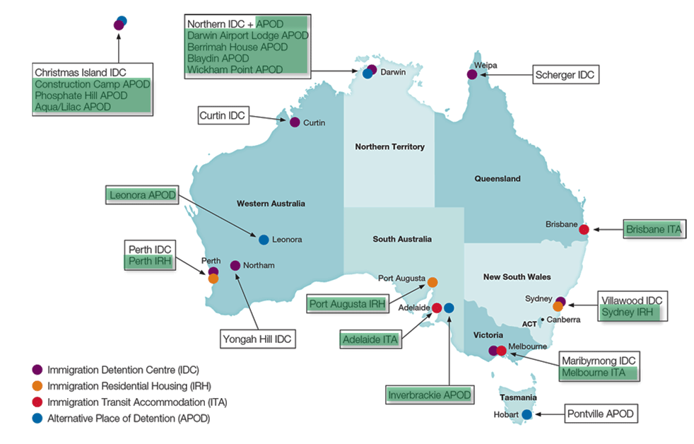
Australia’s immigration detention facilities

Slide 7
Detention statistics
According to Australian Government Department of Immigration and Border Protection statistics, on 31 August 2016, there were 1355 people in immigration detention on the mainland and 247 on Christmas Island (1602 total)
Many will not be asylum seekers, but other migrants without valid visas, or people whose visas have been cancelled
Cf. offshore detention statistics for same reporting date:
410 detainees on Nauru; and
823 detainees on Manus.

Slide 8
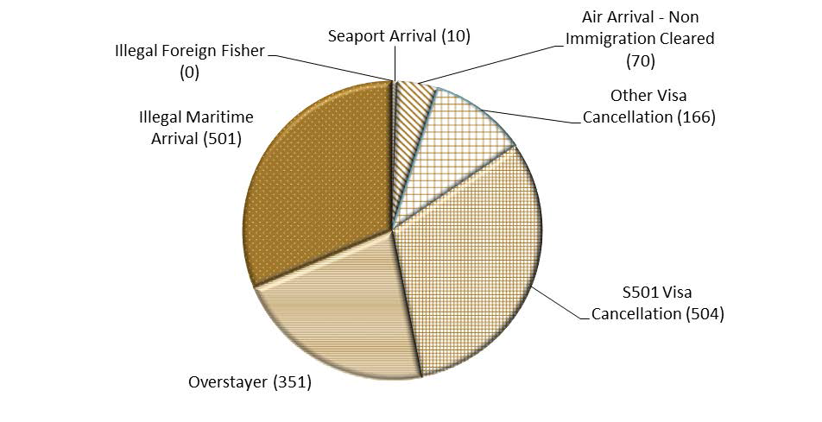
Detention Statistics (mainland and Christmas Island) – Arrival type
“Arrival type” of the 1602 people detained on the mainland or Christmas Island as of 31 August 2016:

Slide 9
Detention Statistics (mainland and Christmas Island) – average time in detention
The average period of time detained for people in immigration detention:
At 31 August 2016: 454 days
At 31 August 2015: 412 days
At 31 August 2014: 391 days
31 August 2013: 89 days
The 2014-2016 figures show a dramatic increase in the average time spent in detention since 31 August 2013

Slide 10
Habeas Corpus challenge to indefinite detention
Al-Kateb v Godwin [2004] HCA 37
The applicant was a stateless Palestinian man born in Kuwait. He arrived in Australia by boat in December 2000 without a visa and was detained.
He applied for a protection(refugee) visa, but was refused. The refusal was confirmed on review by the Refugee Review Tribunal and judicial review was also unsuccessful.
In 2002, the applicant stated he wished to leave Australia. However, attempts by the government to remove the applicant to third countries were unsuccessful.
The applicant faced indefinite detention in Australia.

Slide 11
Al-Kateb v Godwin [2004] HCA 37
The applicant first applied to the Federal Court for a declaration that he was unlawfully detained and an order in the nature of Habeas Corpus directing his release from detention. He was unsuccessful.
There were two main questions for the HCA on appeal:
Whether the Migration Act authorised the applicant’s detention in circumstances where there was no real likelihood or prospect of the applicant’s removal in the reasonably foreseeable future; and
If it did, whether the Migration Act in those circumstances contravened the Constitution because it was punitive and the Constitution did not authorise punitive executive detention, even with a statutory basis.

Slide 12
Al-Kateb v Godwin – the Court’s decision
A majority of the High Court (4 judges, McHugh, Hayne, Callinan and Heydon JJ) found that the Migration Act authorised and required the detention of an unlawful non-citizen, even if his or her removal from Australia was not reasonably practicable in the foreseeable future.
The majority also found that the indefinite detention of non-citizens under the Migration Act was not inconsistent with Ch III of the Constitution (the judicial power). The majority found that the purpose of detention under the relevant provisions was not punitive.

Slide 13
Al-Kateb : the minority reasons
Three judges dissented: Gleeson CJ, Gummow J, Kirby J.
Gleeson CJ: the Court had to choose between a construction of ss 196/ 198 which allowed for indefinite detention and one that did not. His Honour relied on the “principle of legality” to find that liberty cannot be curtailed indefinitely without Parliament manifesting an intention in “unmistakable and unambiguous language.” Sections 196/198 did not do this.
Gummow J ([122]-[123]): for the plaintiff, s 198 no longer retains a present purpose of facilitating removal from Australia which is reasonably in prospect and to that extent the operation of s 198 is spent. Ministerial hope is not enough.
Kirby J ([150]) : agreed with Gummow J, rejected a literal interpretation, which would raise a ‘‘serious constitutional problem’’. Preferred a construction that favoured liberty, and was against indefinite detention, also in conformity with the obligations binding upon Australia under international law and the common law’s strong presumption in favour of liberty.

Slide 14
Other Habeas Corpus cases since Al-Kateb
Re Woolley ex parte Applicants M276/2003 [2004] HCA 49 (detention of children held to be lawful)
Ruhani v Director of Police (No 2) [2005] HCA 43 (appeal from Nauru Supreme Court, habeas corpus re detention under Nauru law)
Plaintiff M76/ 2013 v Minister for Immigration, Multicultural Affairs and Citizenship (plaintiff succeeded on other grounds)

Slide 15
Plaintiff M47/2012 v Director-General of Security [2012] HCA 46 : challenge to Al Kateb
Plaintiff was a Sri Lankan asylum seeker found to be a refugee but denied a protection (refugee) visa because he was the subject of an adverse security assessment by the Australian Security Intelligence Organisation (ASIO). At the time, a criterion for the grant of a protection visa was that the applicant not be assessed by ASIO as a risk to national security.
Plaintiff requested his own removal from Australia after the assessment, but the government could not find a willing third country to accept him.
Plaintiff brought habeas corpus to challenge his indefinite detention, and to challenge correctness of majority view in Al Kateb. The composition of the High Court had changed significantly since Al Kateb. Of the majority in Al Kateb, only Hayne and Heydon JJ remained. Gleeson CJ and Kirby J had also retired.
Plaintiff had other challenges as well (validity of the ASIO criterion and the procedural fairness of the ASIO assessment process ) , and – relevantly - the lawfulness of his continuing detention. In relation to the last argument, he argued that Al-Kateb was wrongly decided and that the Migration Act, properly construed, did not permit indefinite detention. The remedies the applicant sought in relation to the detention ground were a writ for habeas corpus and a declaration that his detention was unlawful.

Slide 16
Plaintiff M47 (cont.)
Majority (French CJ, Hayne, Crennan, Kiefel JJ) : ASIO criterion invalid as inconsistent with the scheme of the Migration Act. Therefore, no valid decision in relation to the applicant's visa application and the detention of the applicant was lawful while a decision on his visa application was pending. This approach taken by the majority meant that they did not need to reconsider Al-Kateb.
However, three judges did reconsider Al Kateb. Two (Gummow J, who was in the minority in Al Kateb and Bell J) found it was wrongly decided.
One, Heydon J, found it to be correct (at [351])
Al Kateb remains the law in Australia on indefinite detention.

Slide 17
Recent developments
Christmas Island Detention Centre class action
A class action has been initiated in the Supreme Court of Victoria against the Minister for Immigration and the Commonwealth on behalf of persons detained on Christmas Island from 27 August 2011 to 26 August 2014
The lead plaintiff’s claim is in negligence
Details are available on the Supreme Court of Victoria website

Slide 18
Alternatives to detention and oversight mechanisms
In 2005, the Australian Parliament made changes to the Migration Act to allow for alternatives to detention and oversight mechanisms:
Community detention (discretionary)
Bridging visas (discretionary)
Independent scrutiny (the Commonwealth Ombudsman)
(See: Peter Billings, ‘Whither Indefinite Immigration Detention in Australia? Rethinking Legal Constraints on the Detention of Non-Citizens’ (2015) 38(4) UNSW Law Journal 1386, pp 1396-1399)

Slide 19
Non-judicial oversight mechanisms currently available in Australia
The Commonwealth Ombudsman
An independent statutory agency.
Investigates complaints against Australian Government officials, agencies and their service providers.
Conduct its own motion investigations into the actions of government agencies.
The Migration Act 1958 (Cth) also requires the Commonwealth Ombudsman to send to the Minister of Immigration and Border Protection an assessment of the appropriateness of the arrangements for the detention of every person who has been in immigration detention for more than two years

Slide 20
The Commonwealth Ombudsman
The assessment may include any recommendations the Ombudsman considers appropriate, including:
another form of detention would be more appropriate,
a person be released into the community on a visa, or
general recommendations about the Department’s handling of the detainee caseload.
The Ombudsman’s assessment is provided to the Minister in a report, with a de-identified copy which the Minister must table in Parliament.
The Minister is not bound by any recommendations the Commonwealth Ombudsman makes.

