Slide 1
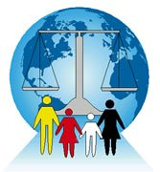

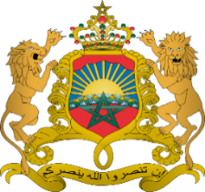






International Association of Refugee Law Judges (IARLJ)
Africa Regional Chapter Conference
Hotel Palm Plaza
Marrakesh, Morocco
November 25th - 27th, 2015

Slide 2
Addressing Forced Displacement within the African Continent through Progressive Legislative Developments and the Critical Role of the Judiciary
Address by Ahmed Arbee
The challenges of Addressing the Protection needs of Refugees and Asylum Seekers in Africa – Marrakesh 25 – 27 Nov 2015

Slide 3
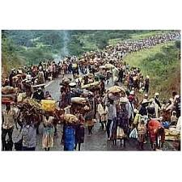
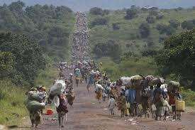
Pictures to Ponder Catastrophic Consequences in Burundi

Slide 4
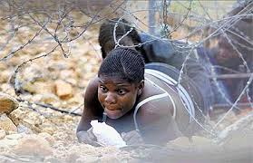
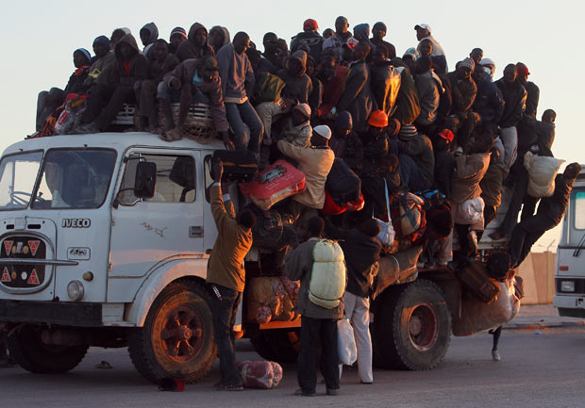
Desperate Journeys

Slide 5
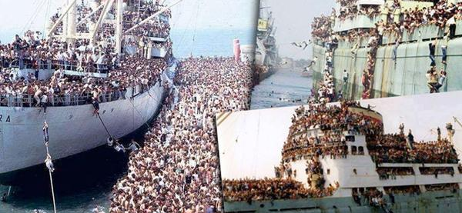
Libya refugee boat sinkings

Slide 6
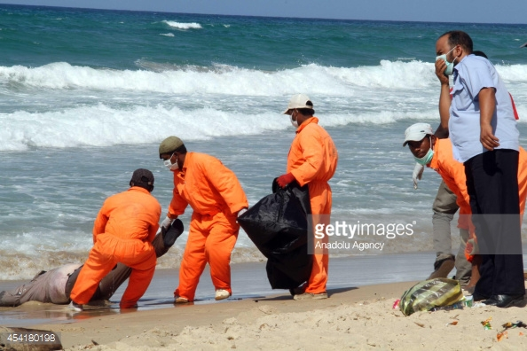

Slide 7
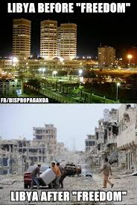
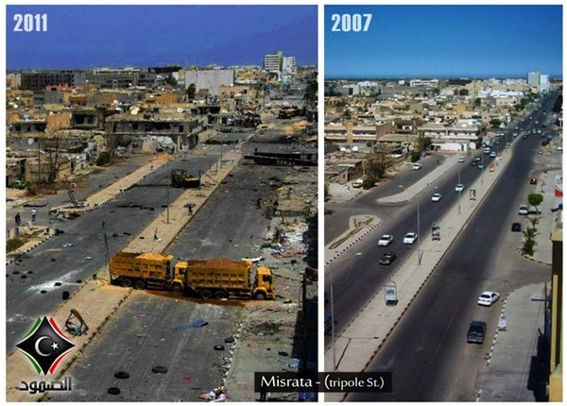
Libya before and after

Slide 8

Little Aylan washed ashore

Slide 9
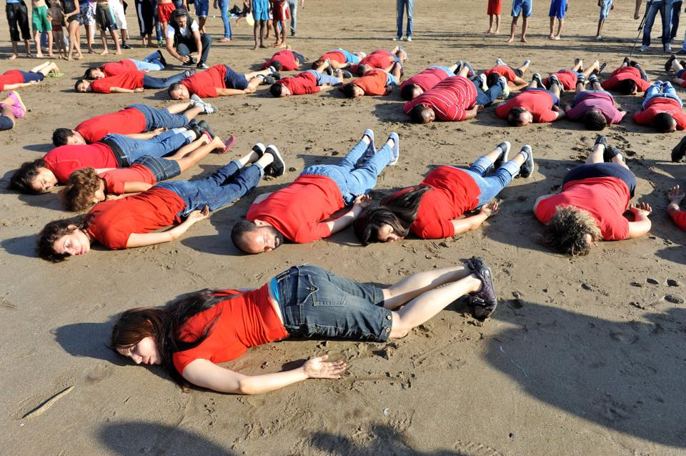
Moroccans Lie Face down in Solidarity with Little Aylan and other Refugees

Slide 10
Morocco has been traditionally a land offering refuge to people fleeing from persecution.
Morocco hosted hundred of thousands of Muslims and Jewish families who fled the religious persecution in Spain between the 15 and 18 centuries.
During the Algerian Independance Revolution (1954-1962), Morocco hosted Algerian families who fled the war.
In response to this crisis, UNHCR had started its operations to support refugees outside Europe for the first time in its history

