Slide 1
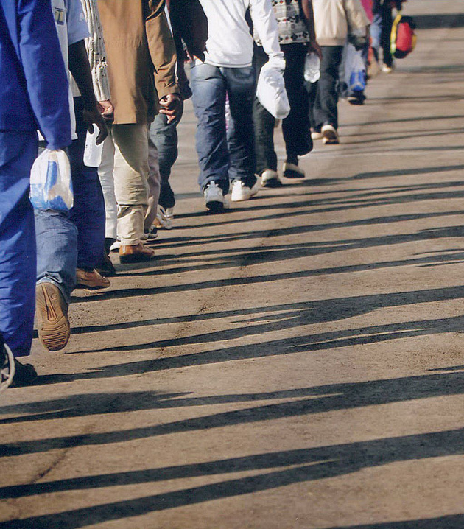
Development of the international legal framework on refugee protection
Jacob van Garderen
The Public Interest Practice
Notes:
Good morning and welcome to

Slide 2
Introduction
States are responsible for protecting the rights of their citizens. When governments are unable or unwilling to protect its citizens, they are forced to flee their country and seek safety elsewhere, another country has to step in to ensure that the refugees’ basic rights are respected. This is known as “international refugee protection”.
Lecture overview
  Origins of international refugee law
  Early measure to create international norms
  World War II and the 1951 UN Convention
  Regional treaties and other human rights instrument
  1969 OAU Convention

Slide 3
International Origins of Refugee Law
The ancient roots of refugee protection
  fundamental principles of modern refugee law are asylum and non-refoulement.
    Asylum - discretionary recognition of formal legal status to refugees by states .
    The norm of non-refoulement imposes an obligation on state parties not to return refugees to countries in which their lives of freedom would be threatened.
  While these concepts have matured during the 20th century and formalised in the 1951 UN Convention and 1969 OAU Refugee Convention, these principles extend deep into ancient religious and societal norms, most notably Arab Islamic, Judeo-Christian and African traditions.

Slide 4
Protecting the stranger / concept of hospitality in the ancient Arab world
  The tradition of sheltering and protecting strangers is deeply embedded in human history, especially within early Islamic practices.
  One significant example is the ijara, a tribal custom that the Prophet Muhammad himself benefited from. This practice, rooted in the tribal humanism of desert Arabs, offered hospitality and legal immunity to wayfaring strangers.
  In early Islamic times, the principle of aman—temporary protection—was extended to strangers seeking refuge in the lands of Islam. Every tribe, town, and country was expected to provide asylum and protection to those on its territory, regardless of their circumstances.
  Under aman, strangers could rely on the collective protection of their host, with the entire family or community ensuring their safety. The Sharia further enshrined this obligation, calling on Muslims to grant asylum and safeguard non-Muslim strangers fleeing persecution, particularly in times of war, thus reflecting Islam’s broader principles of mercy, protection, and justice for those in need.

Slide 5
The Concept of Church Sanctuary and its Judeo-Christian Roots
Definition of Church Sanctuary:
  The practice of offering protection or refuge within a church. Shielding individuals from arrest, punishment, or harm.
Judeo-Christian Heritage:
  Old Testament Roots
  "Cities of Refuge" (Numbers 35:9-28) established as safe zones.
  Provided protection to those accused of manslaughter until a fair trial.
  Sacred spaces seen as places of justice and mercy.
Early Christian Tradition
  4th Century onwards, churches became sanctuaries for those facing unjust punishment or persecution. Reflecting divine mercy, offering temporary refuge while cases were considered. Physical church boundaries symbolized moral authority and spiritual protection.

Slide 6
African traditions
  Traditional African principles of sanctuary and protection for those seeking refuge are deeply rooted in the continent's diverse cultural, ethical, and social frameworks. These principles vary across different African cultures but share common themes of hospitality, community responsibility, and respect for human dignity.
  Southern Africa - Ubuntu
  This philosophy emphasizes 'I am because we are', underscoring the interconnectedness of people and communities. In the context of sanctuary and protection, Ubuntu advocates for a deep sense of shared humanity, where taking in and protecting refugees and those in need is seen as a responsibility and an extension of one's own well-being.
  West Africa - Ashanti
  In traditional Ashanti culture in Ghana, the protection of strangers and guests is a significant aspect of their social and ethical values. This tradition, rooted in their history and cultural practices, reflects a broader African ethos of hospitality and communal responsibility.

Slide 7
Early efforts to establish international mechanisms to protect refugees
  Refugees may have been around as long as history but an awareness of the responsibility of the international community to provide them protection and help them solve their problems dates only from the time of the League of Nations.
  The first demonstration of this international solidarity emerged after World War I, to deal with mass movements linked mainly to the Russian Revolution and the collapse of the Ottoman Empire.
  In 1921 Fridtjof Nansen was elected by the League of Nations as High Commissioner for Russian refugees and his tasks were to define their legal status and to organise their repatriation or allocations to countries able to receive refugees

Slide 8
Word War II
The mass expulsions and persecutions before, during and after the Second World War have shaped the contours of international refugee law until this very day.
In 1938, a number of states agreed on the Convention concerning the Status of Refugees coming from Germany.
The plight of refugees in the aftermath of the Second World War was addressed in Article 14 of the 1948 Universal Declaration of Human Rights which includes a right to asylum (this was, however, not meant to be an individual right but rather, it confirmed the right of a state to grant asylum).
The most decisive development was the adoption of the UN Convention Relating to the Status of Refugees on 28 July 1951, a comprehensive and legally binding international instrument in universal refugee law and its key provisions remain applicable until this very day.
Establishment of UNHCR

Slide 9
1951 UN Refugee Convention
State responsibility starts with addressing root causes of forced displacement. Strengthening the rule of law and providing citizens with security, justice, and equal opportunities are crucial to breaking the cycles of violence, abuse and discrimination that can lead to displacement.
When countries accede to the 1951 Convention / 1967 Protocol, they agree to protect refugees on their territory. States have also agreed to extend relevant rights to refugees in accordance with international human rights obligations.
Even States that are not party to the Convention or Protocol are bound by the principle of non-refoulement, which is considered a norm of customary international law and as such is binding on all States.

Slide 10
Right to seek and enjoy asylum
Article 14, Universal Declaration of Human Rights, Article 14
“Everyone has the right to seek and to enjoy in other countries asylum from persecution”
In Africa, Article 12(3), ACHPR
“Every individual shall have the right, when persecuted, to seek and obtain asylum in other countries in accordance with the law of those countries and international conventions.”

Slide 11
Refugee definition under 1951 Refugee
Article 1A(2) read in conjunction with Protocol 1967
any person who ‘…owing to a well-founded fear of being persecuted for reasons of race, religion, nationality, membership of particular social group or political opinion, is outside the country of [their] nationality and is unable or, owing to such fear, is unwilling to avail [themself] of the protection of that country; or who, not having a nationality and being outside the country of his former habitual residence … is unable or, owing to such fear, is unwilling to return to it.

Slide 12
Regional human rights instruments
In Africa, several regional human rights instruments that are relevant to the protection of refugees
  1969 OAU Convention Governing the Specific Aspects of Refugee Problems in Africa
  African Charter on Human and Peoples’ Rights;
  Protocol on the Rights of Women in Africa;
  African Charter on the Rights and Welfare of the Child
Americas
  Like the OAU Convention, the 1984 Cartagena Declaration adds a regional definition, complementing the 1951 Convention refugee definition to include persons who flee their countries “because their lives, safety or freedom have been threatened by generalized violence, foreign aggression, internal conflicts, massive violation of human rights or other circumstances which have seriously disturbed public order”.

Slide 13
Regional human rights instruments (Europe)
The most far-reaching regional developments have come from the European Union (EU). In 1999 EU created a common European asylum system based on the 1951 Convention.
Since then, four key legislative instruments have been adopted. Each adds content to refugee law in an area not addressed by the 1951 Convention. These instruments concern: (a) temporary protection; (b) the reception of asylum-seekers; (c) qualification for refugee status or “subsidiary protection” and the rights and status to which beneficiaries are entitled; and (d) standards for asylum procedures.
In addition, the “Dublin III Regulation” sets out the criteria for determining which EU Member State or other participating country is responsible for examining an asylum application

Slide 14
International legal instruments protecting refugees
International Covenant on Civil and Political Rights
International Covenant on Economic, Social and Cultural Rights
Convention against Torture
Convention on the Rights of the Child
Convention on the Elimination of All Forms of Racial Discrimination
Convention on the Elimination of All Forms of Discrimination against Women
Convention on the Rights of Persons with Disabilities
International Convention for the Protection of All Persons from Enforced Disappearance

Slide 15
Development of a regional approach to refugee protection
In 1969 the OAU adopted the OAU Convention Governing the Specific Aspects of Refugee Problems in Africa. At the time, the OAU Convention represented the most significant regional development in refugee law since the 1951 UN Convention.
By its terms, the OAU Refugee Convention envisioned a cohesive and humanitarian approach to refugee policy and practice in Africa.
Over time, Article I(2) of the Convention also influenced UNHCR’s mandate.
Despite most African countries ratifying the OAU Refugee Convention and have applied its provisions through domestic legislation, the reality 60 years on remains far removed from the lofty ideals espoused by the treaty. In the words of George Okoth-Obbo:
  In most of Africa, the picture of a deep-seated crisis in the Continent’s asylum policies, practices and even laws is overpowering. The erosion of the much-vaunted African hospitality towards refugees, the waning of which was the subject of a waning already several years ago, is now indisputable. The containment of refugees has leapt ahead of their protection as the main priority of states in many a country. As if to underline this trend, Africa has been the arena for some of the most biting failures in the protection of refugees of recent times.

Slide 16
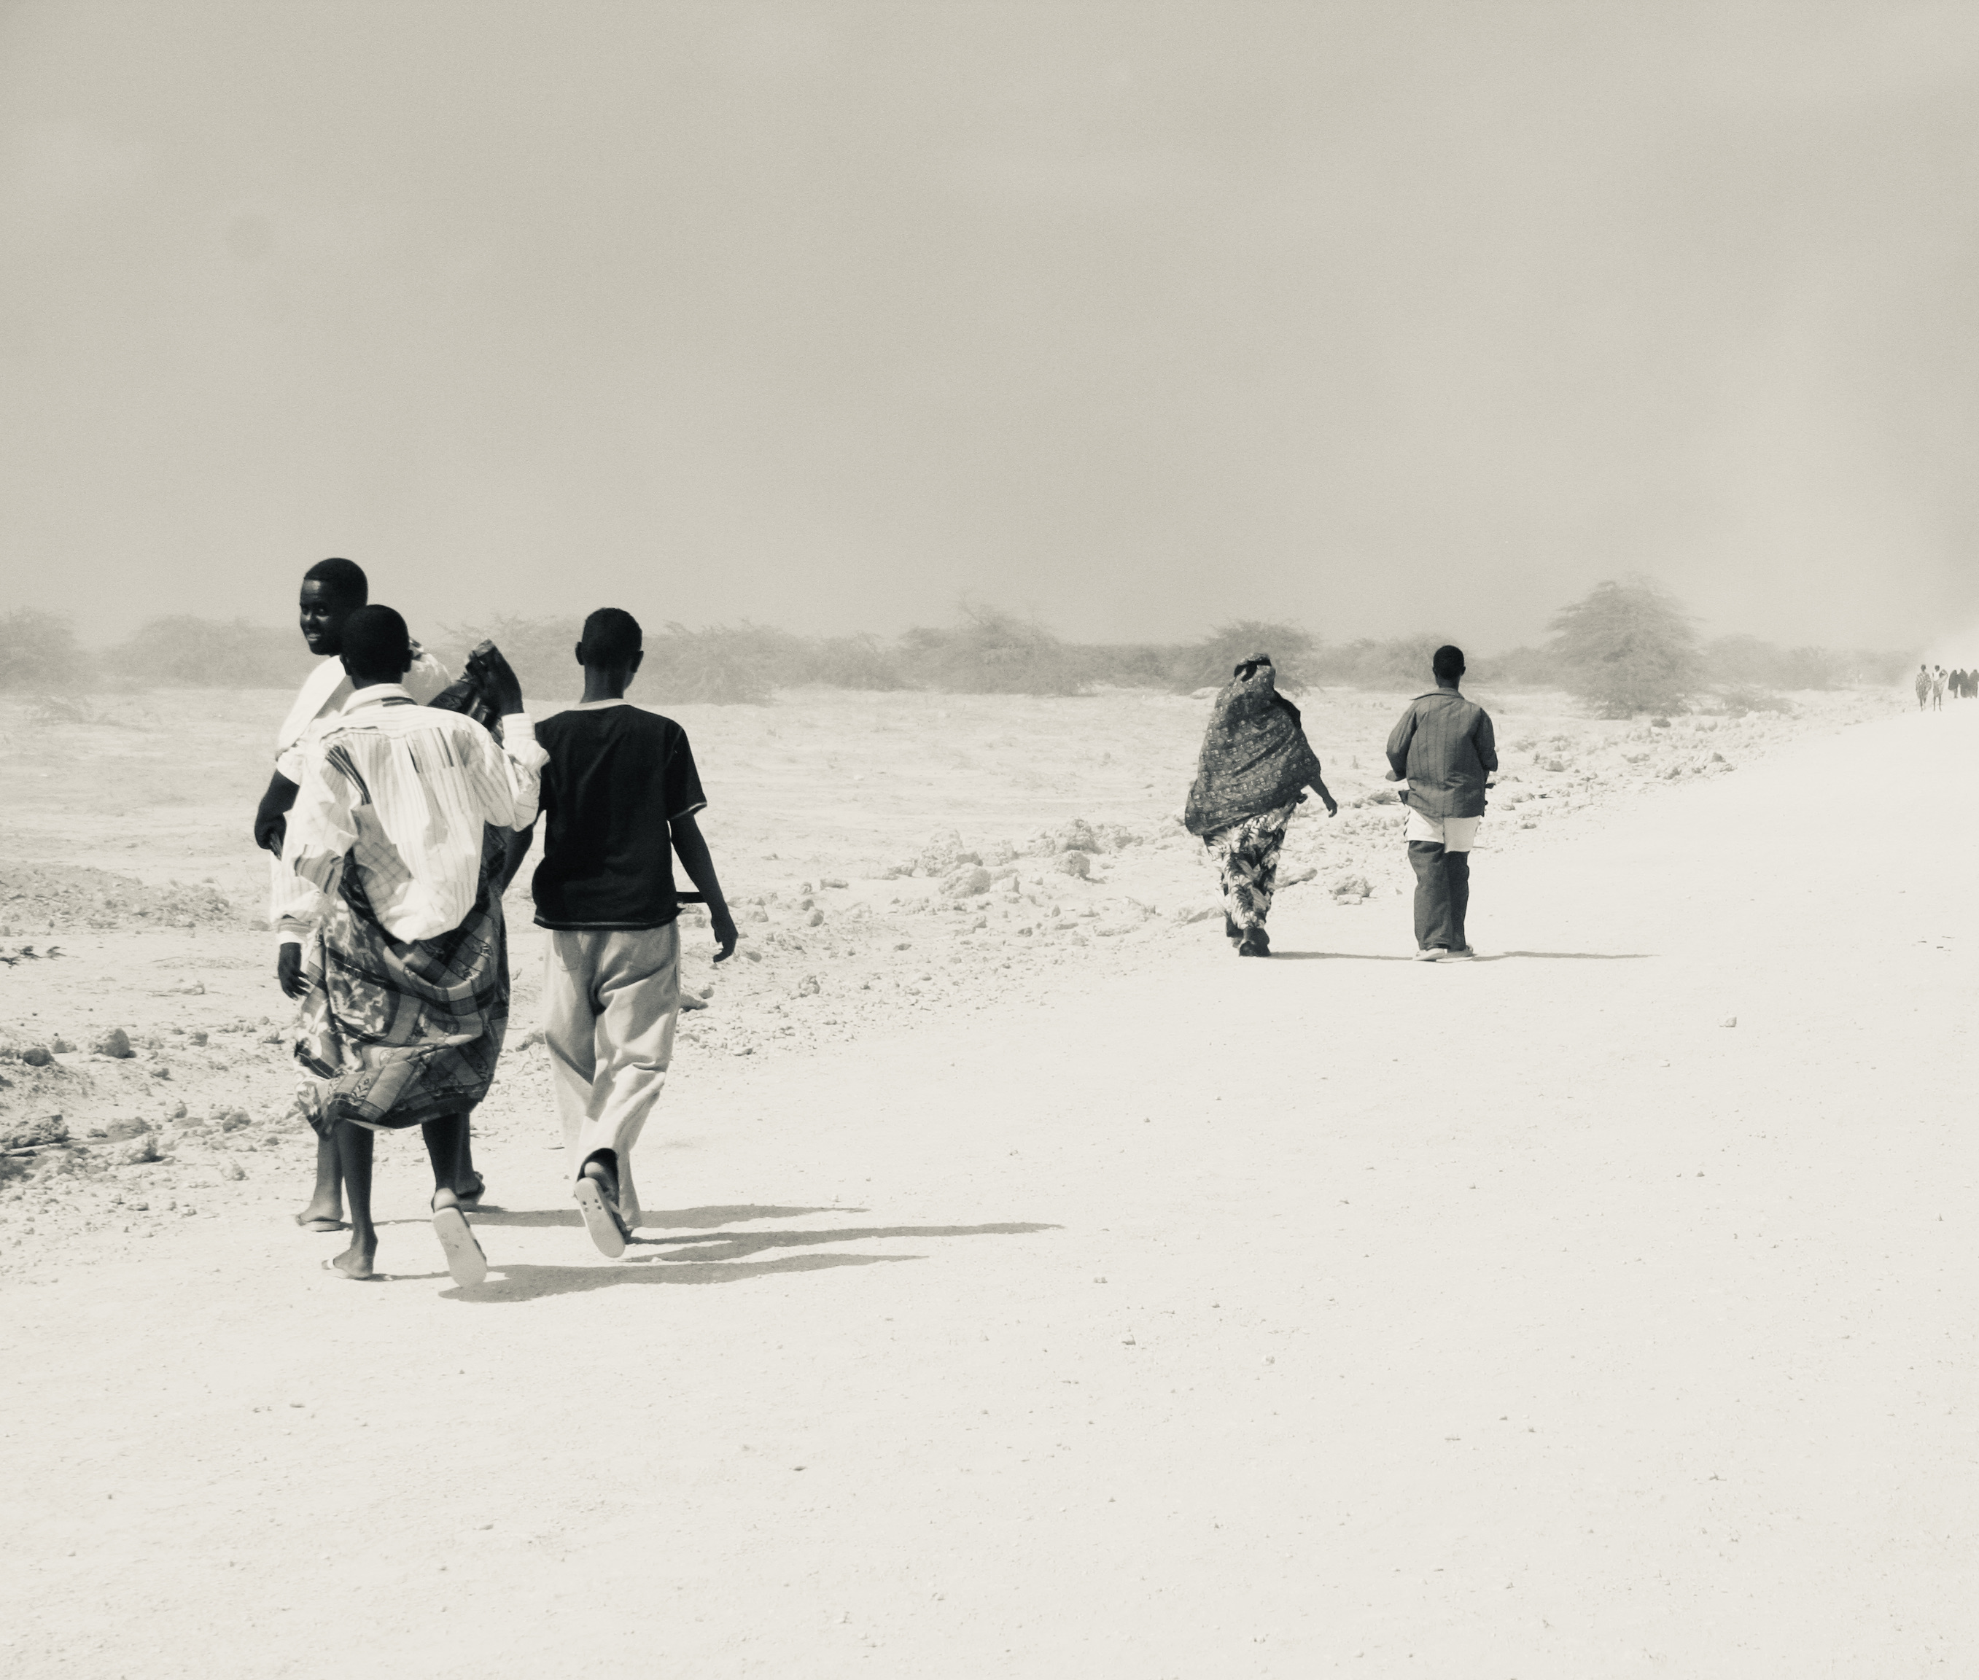
Historical Patterns of Conflict and Displacement
Forced displacement has been a constant feature of the African region. In 2024, Sub-Saharan Africa continues to host a quarter of the world refugee population caused by protracted armed conflicts raging in Sudan, Central African Republic and Ethiopia. More than a quarter of the world refugee population is hosted in Sub Saharan Africa.
Historical patterns of migration and displacement, and the corresponding response of African States can roughly be divided into two main periods since the advent of the 1951 Convention.
  The early 1960s through the late 1980s - fighting against colonialism, occupation, and racist governments.
  In the late 1980s and 1990s, the root causes of displacement began to change, and receiving States’ policies and attitudes towards refugees changed as well
States began to implement more restrictive policies even as the OAU Refugee Convention advanced expanded legal rights for refugees

Slide 17
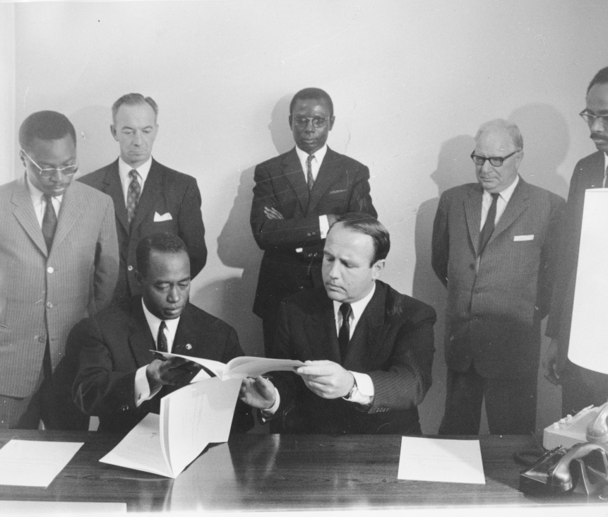
1969 OAU Convention Governing specific Aspects of Refugee Problems in Africa

Slide 18
Background
Established as a regional complement to the 1951 Convention and the 1967 Protocol. The principal objectives:
  to ensure the security and peaceful relations among OAU member States, particularly in cases where the presence of refugees causes inter-State tension.
  to complement the 1951 Convention with its temporal and geographical limitations.
  to address the refugee challenges peculiar to Africa. The concern was that the 1951 Convention did not include refugees displaced from countries ruled by colonial powers and white racist regimes.
  The right to seek asylum supported by Art. 12 of the African Charter, which states that ‘every individual shall have the right, when persecuted, to seek and obtain asylum in other countries in accordance with laws of those countries and international conventions’.

Slide 19
Expanding protection
It increased the scope of protection by expanding the definition of ‘refugee’ to include those fleeing events causing instability in their countries (Art. 1) and by extending the protection against refoulement to include frontiers (Art. 2).
Promotes international relations and security by prohibiting subversive activities by refugees present in host countries,
Places the duty to prevent subversion on both the individual seeking asylum and the host State (Art. 3).
Sets rules surrounding repatriation

Slide 20
Expanded Definition of the Term ‘Refugee’
Article 1 OAU Refugee Convention reads:
  For the purposes of this Convention, the term ‘refugee’ shall mean every person who, owing to a well-founded fear of being persecuted for reasons of race, religion, nationality, membership in a particular social group or political opinion, is outside the country of his nationality and is unable or, owing to such fear, is unwilling to avail himself of the protection of that country, or who, not having a nationality and being outside the country of his former habitual residence as a result of such events is unable to or, owing to such fear, is unwilling to return to it.
  The term ‘refugee’ shall also apply to every person who, owing to external aggression, occupation, foreign domination, or events seriously disturbing public order in either part or the whole of his country of origin or nationality, is compelled to leave his place of habitual residence in order to seek refuge in another place outside his country of origin or nationality.

Slide 21
Expanded definition
Definition can be broken down into three primary clauses.
First, a refugee must be compelled to leave his country of origin owing to one of the four enumerated events: external aggression, occupation, foreign domination, or events seriously disturbing or disrupting public order.
In contrast to the 1951 Convention, the definition in the OAU Refugee Convention places a bigger emphasis on objective circumstances that lead to the refugee’s flight rather than the subjective inquiry into a person’s fear of persecution.
The definition does not require the same ‘quality of deliberateness’ in relation to the cause of flight found in the 1951 Convention, where claimants must show that they had been deliberately targeted for persecution by a persecuting actor.
Sharpe cautions against the conclusion that the OAU refugee definition is based solely on objective criteria.

Slide 22
Expanded definition
The inclusion of the first three terms or events, ‘aggression’, ‘occupation’, and ‘foreign domination’, was prompted by the reality of the political environment in the late 1960s when the OAU Refugee Convention was drafted and is well suited to the refugee- creating situations of the 1960s and 1970s, including refugees fleeing Apartheid in South Africa
‘Aggression’ the use of armed force by a State against the sovereignty, territorial integrity or political independence of another State,
‘Occupation’ partial or total occupation of the territory of country
‘Foreign domination’ colonial occupation, where ‘aggression’ and ‘occupation’ definitions did not adequately address the circumstance where a colonial government was a sovereign power but did not recognize the sovereignty of the dominated territory.

Slide 23
Expanded definition: Events seriously disturbing public order
‘Events’ interpreted to be any man-made event. What about climate-induced forced migration?
‘Seriously disturbing’ goes to the intensity or extent of the disturbance of public order. The threshold requirement would necessitate the events to be prolonged, on a massive scale, or harmful to life, freedom and security’, which includes civil conflicts, coups d’états, militia or rebel group insurgencies.
‘Public order’ when the event ‘constitutes a threat to an uncertain number of persons or to society at large. The threshold for the disruption - widespread violation of fundamental human rights, e.g. protection against torture or freedom from arbitrary detention.
In the current day context of conflicts among local groups, or between government forces and local groups, it is not just the loss government control but rather the impact of the loss of control on the protection of civilians. Thus the test for a disturbance of public order is an objective one, as the concern is public disorder and not an individual’s subjective emotional state and considers the gravity of the harm in relation to what can normally be expected of public order.
Sharpe warns against using the category of ‘events seriously disturbing public order’ as a catch-all. Instead, it’s a distinct category that offers protection to persons fleeing internal or international conflicts that threaten life, security, or freedom.

Slide 24
Expanded definition: in either a part or the whole of his or her country of origin or nationality
Refers to the location or the degree of the causal event.
does not require that an applicant exhaust all remedies within his or her country of origin and seek an Internal Flight or Relocation Alternative (IFRA). By contrast to ‘51 Convention, the possibility of internal relocation is irrelevant to claims under the OAU Refugee Convention

Slide 25
Expanded definition: habitual residence
Habitual residence requirement that an applicant ‘is compelled to leave his place of habitual residence in order to seek refuge [elsewhere]’ creates a geographical nexus between the enumerated event and the applicant’s flight (but does not require an exhaustion of internal relocation options).
The term ‘habitual residence’, as opposed to simply ‘residence’, should be understood as a link between an individual and a place, and a ‘durable connection’. That durable connection can be reflected in either a long stay, or particularly close familial, social, or cultural ties between the person and that place. The required nexus is between the disturbing event and the flight from an applicant’s habitual residence, and would cover an asylum applicant who is internally displaced or takes up temporary residence in a secondary location in his or her country of origin, before seeking refuge in another country.

Slide 26
Expanded Protection Against Refoulement
Article 2, para. 3 OAU Refugee Convention reads:
  No person shall be subjected by a Member State to measures such as rejection at the frontier, return or expulsion which would compel him to return to or remain in a territory where his life, physical integrity or liberty would be threatened for the reasons set out in Article 1, paras. 1 and 2.
Prohibits the rejection of persons at a frontier when such rejection would compel a person to remain in a territory where his life, physical integrity, or liberty would be threatened
Expands the protection against refoulement in the 1951 Convention by expressly granting protection against rejection at a frontier. Also confers responsibility on states to protect against ‘measures . . . which would compel him to . . . remain in a territory’ under threat, which include an obligation to protect persons against internal displacement. The advent of ‘safe zones’, or protected refugee settlements within a country for those who cannot seek protection of that country’s government and would otherwise flee, may be an insufficient solution to refugee situations, based on the criteria of this article.

Slide 27
Expanded Protection: Subversive activities
Article 3: Every refugee has duties to the country in which he finds himself, which require in particular that he conforms with its laws and regulations as well as with measures taken for the maintenance of public order. He shall also abstain from any subversive activities against any Member State of the OAU. Signatory States undertake to prohibit refugees residing in their respective territories from attacking any State Member of the OAU, by any activity likely to cause tension between Member States, and in particular by use of arms, through the press, or by radio.
One of the reasons given for the decline in African States’ willingness to offer asylum is the potential risk refugee populations pose to the social stability and national security of host States.
Promotes international relations and security by prohibiting subversive activities by refugees present in host countries, and places the duty to prevent subversion on both the individual seeking asylum and the host State.
This provision is supported by the exclusion clause which disqualifies asylum claimants for committing ‘acts contrary to the purpose and principles of the OAU. Has been criticized as being overbroad.

Slide 28
Expanded Protection: Burden sharing
The principle of burden sharing reflects the historical reality that certain States, due to their geographical location, are forced to accept larger numbers of refugees than other States who may be further removed from conflict zones.
Article 2 states that “Where a member State finds difficulty in continuing to grant asylum to refugees, such Member State may appeal directly to other Member States and through the OAU and such Member States shall in the spirit of African solidarity and international co-operation take appropriate measures to lighten the burden of the Member State granting asylum.
Although there may be little controversy over the principle of burden sharing, the reality and effectiveness of it have been questioned. Without a legal and administrative mechanism to assist countries who need support in providing protection to refugees, the equitable burden sharing provision will remain a distant ideal.

Slide 29
Expanded Protection: Voluntary repatriation
Article 5 creates a detailed framework on the voluntary repatriation of refugees in Africa. Underlying these principles is the OAU intention to foster good relations and security between States.
While the OAU preferred local integration during the 1960s and 1970s, in more recent years a shift has occurred to promote voluntary repatriation as the most appropriate solution to Africa’s problems, which mirrors the international trend.
African States are increasingly repatriating refugees at the earliest opportunity, often in less than ideal circumstances. In a number of instances the premature repatriation of refugees has led to disastrous consequences, e.g. the forced repatriation of Rwandan refugees from the former Zaire and Tanzania in 1996.

Slide 30
The OAU Refugee Convention in Domestic Law
The OAU Refugee Convention enjoys broad recognition in the region and has been ratified by 47 of the 55 AU member states. Significant number of countries who have incorporated the convention in national refugee laws and policies.
Increasingly, states conduct their own refugee status determination procedures while only a few examples of RSD conducted by UNHCR.
The development of domestic refugee legislation has been characterized by three major development stages. First, specific legislation was not in evidence— refugee issues falling within general immigration legislation. Secondly, emphasis was placed on refugee control, as opposed to protection. Lastly, commencing in the 1980s, emphasis was placed on refugee protection, including the non-refoulement principle.

Slide 31
African Commission on Human and Peoples’ Rights
The African Commission on Human and Peoples’ Rights is the supervisory organ of the African Charter of Human and Peoples’ Rights (ACHPR) and comprises 11 members who serve in their personal capacities. The core mandate of the Commission is ‘to promote human and peoples’ rights and to ensure their protection in Africa’ through promotional work to protect rights, setting standards through the formulation of human rights-based principles, protective work through an individual and interstate complaints mechanism and an advisory function to assist with the interpretation of the ACHPR.
Article 55 ACHPR allows individuals and NGOs to lodge complaints against the governments of member States. Unfortunately, the Commission has not heard many complaints that have a direct bearing on refugee rights.

Slide 32
African Commission on Human and Peoples’ Rights
However, the following selection of cases has some relevance:
  In Rencontre Africaine pour la Défence des Droits de l’Homme v. Zambia the Commission found that the mass expulsion of 517 West African nationals from Zambia without any opportunity to challenge the expulsion was a violation of Art. 12, para. 5 ACHPR.
  In Organisation Mondiale contre la Torture v. Rwanda the Commission found that the mass expulsion of Burundian refugees of Hutu identity by the Rwanda government presented a ‘special threat to human rights’
  In African Institute for Human Rights and Development (on Behalf of Sierra Leonean Refugees in Guinea) v. Guinea the Commission ruled that Guinea was in violation of the ACHPR and article IV of the OAU Refugee Convention after the President incited soldiers and civilians over national radio to arrest all Sierra Leonean refugees and detain them in refugee camps. The President’s call led to mass human rights abuses, including eviction, looting, extortion, and arbitrary arrests. As a result, large numbers of refugees were forced to flee Guinea.

Slide 33
African Commission on Human and Peoples’ Rights
In Union interafricaine des droits de l’homme and others v Angola it was held that the mass expulsion of West Africans infringed on the rights to non-discrimination, the right to have one’s counsel heard, as well as the provisions against the expulsion
In the matter of John D Ouko v Kenya, the Commission held Kenya, as country of origin, responsible for human rights violations of a student activist, including his arrest and detention in inhumane conditions that led to the flight of a student leader into exile.
In matters of Malawi African Association and Others v Mauritania and Sudan Human Rights Organisation & Centre on Housing Rights and Evictions (COHRE) v Sudan, the Commission addressed the responsibilities of refugee-producing states to returning refugees

Slide 34
African Commission on Human and Peoples’ Rights
In 2000 the Commission and UNHCR set out to strengthen the Commission’s capacity to monitor States’ compliance with the OAU Refugee Convention and to encourage States to implement the OAU Refugee Convention in domestic law.
This process culminated in the signing of a memorandum of understanding that specified areas of cooperation including research, information sharing, training and joint action to implement resolution on refugees. Yet, little progress was made to implement these measures and the initiative to establish the commission as a regional mechanism to enforce the OAU Refugee Convention remains has not been achieved.

Slide 35
African Commission on Human and Peoples’ Rights
In 2004, the Commission established the Special Rapporteur on Refugees, Asylum Seekers and Internally Displaced Persons with the following powers:
  to receive, examine and act upon information on the situation of refugees, asylum seekers and internally displaced persons in Africa;
  to undertake studies, research and other related activities to examine appropriate ways to strengthen the protection of refugees and internally displaced persons;
  to undertake fact-finding missions, investigations, visits and other appropriate activities to refugee camps and camps for internally displaced persons;
  cooperate and engage in dialogue with member states, national human rights institutions, relevant intergovernmental and non-governmental bodies, international and regional mechanisms involved in the promotion and protection of the rights of refugees, asylum seekers and internally displaced persons;
  to assist AU member States to develop appropriate policies and laws for the effective protection of refugees and internally displaced persons; and
  to submit regular reports to the ordinary sessions of the Commission.

Slide 36
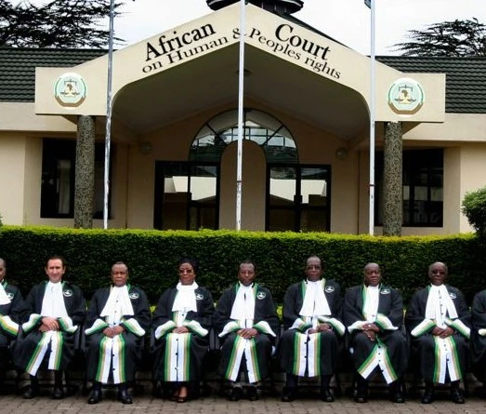
The African Court on Human and Peoples’ Rights
The African Court on Human and Peoples’ Rights came into operation in 2004 following the adoption of the African Court Protocol, establishing a regional court with eleven judges elected by the AU Assembly.
The Court has jurisdiction to hear cases concerning the African Charter, its own protocol and any other relevant human rights instrument, including the OAU Refugee Convention, ratified by the states concerned.
However, the Court’s rules on standing prohibits an individual or non-governmental organisations from litigating cases unless the state in question has filed a declaration in terms of article 34(6) allowing such individuals and organisations legal standing to do so. As a result, the Court has not yet adjudicated a refugee matter.

